Slide 1
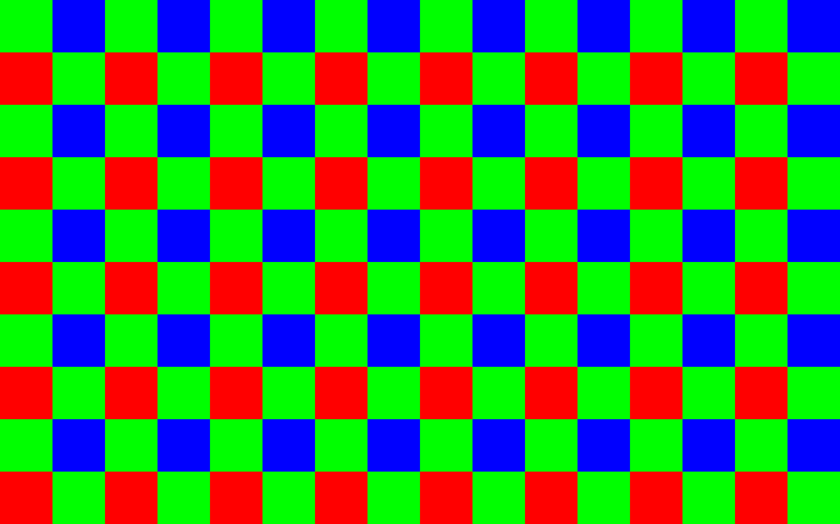

Slide 2
Ist Zustand Perske
Memory Access Control
CAM Data Mux
SDRAM Write Buffer
SDRAM Controler
SDRAM Read Buffer
CAM
SDRAM Pixel Buffer
Debay
Convo-lution
VGA

Slide 3
SDRAM_Pixelbuffer
Block 1
SDRAM
pxl_data_l1
pxl_data_l2
pxl_data_l3
pxl_data_l4
pxl_data_l5
Block 2
pxl_data_l1
pxl_data_l2
pxl_data_l3
pxl_data_l4
pxl_data_l5

Slide 4
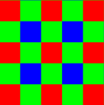
SDRAM_Pixelbuffer_nächste_Zeile
Block x
SDRAM
pxl_data_l1
pxl_data_l2
pxl_data_l3
pxl_data_l4
pxl_data_l5
Block x+1
pxl_data_l1
pxl_data_l2
pxl_data_l3
pxl_data_l4
pxl_data_l5

Slide 5
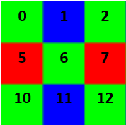
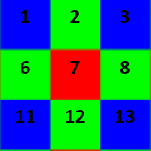
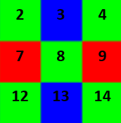
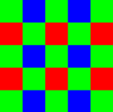
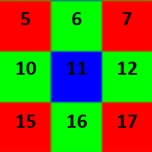
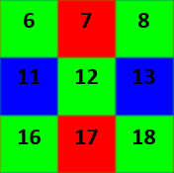
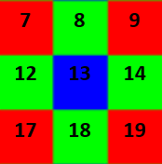
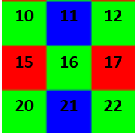
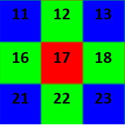
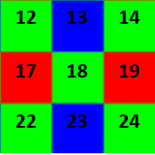
Debay
9 x 3 x 3 Byte Blöcke
5x5 Byte Block
0 | 1 | 2 | 3 | 4
5 | 6 | 7 | 8 | 9
10 | 11 | 12 | 13 | 14
15 | 16 | 17 | 18 | 19
20 | 21 | 22 | 23 | 24

Slide 6
Debay rgb channel
R Kanal, 3x3 Byte
Rl1
Rl2
Rl2

Slide 7
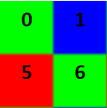
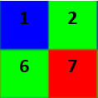
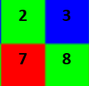
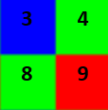
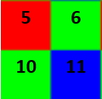
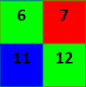
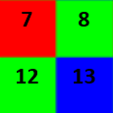
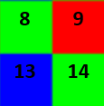
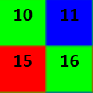
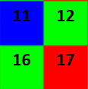
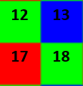
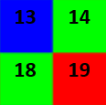
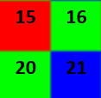
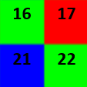
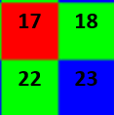
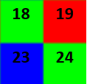
Gedankenspiel Oster
0 | 1 | 2 | 3 | 4
5 | 6 | 7 | 8 | 9
10 | 11 | 12 | 13 | 14
15 | 16 | 17 | 18 | 19
20 | 21 | 22 | 23 | 24

